Slide 1


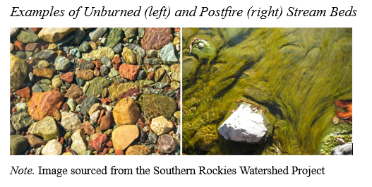
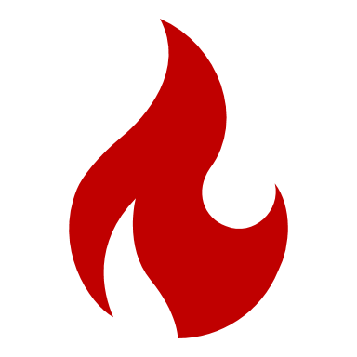
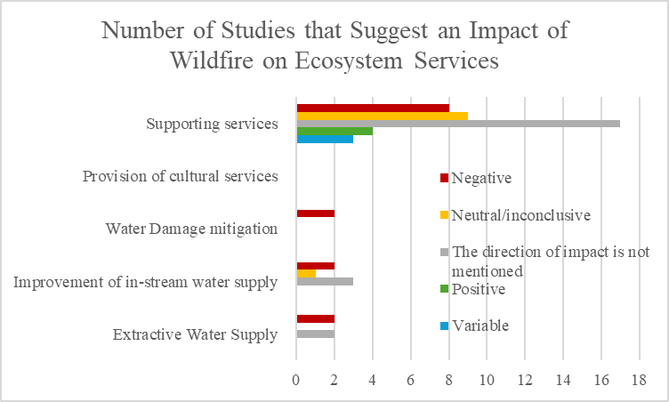
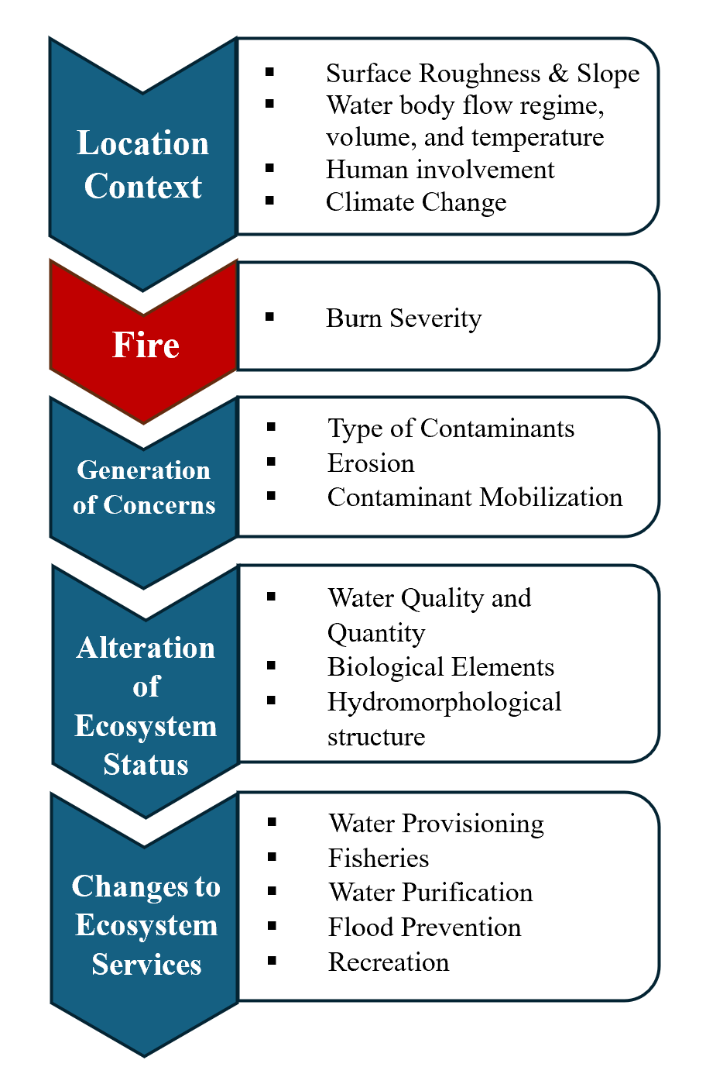
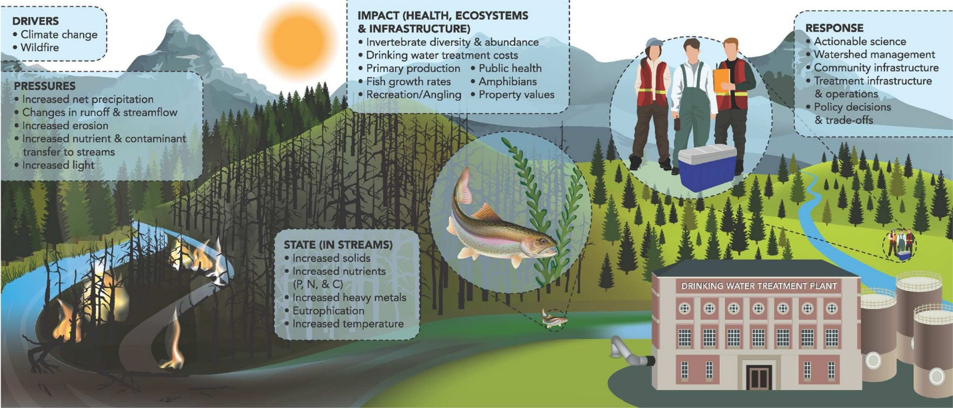
Wildfire and the Future of Water
Tasmia Zaman Apsara & Erin Clarke
Introduction
Figure 2
Effect of Various Pollutants on Water Quality in the Stream Bed Postfire
Wildfires are growing in severity and frequency (Bladon et al., 2014; Northwest Fire Science Consortium, n.d.).
Water resources provide a multitude of benefits to humans and are critically essential for the ecosystem.
Water resources are impacted by wildfires (Bladon et al., 2014).
Objective & Importance
Sourced from Bladon et al., 2014
To provide a comprehensive understanding of the literature surrounding the effects of wildfire on the value of water. Raising awareness will help identify areas for improvement and policy considerations for future water management to help avoid lasting impacts on public health and minimize future water treatment infrastructural costs (Bladon et al., 2014).
Figure 3
Studies that Suggest the Impact of Wildfire on Ecosystem Services
Literature Review
Figure 1
Integrated Framework of Fire-Water Interaction
Nunes et al. (2018), introduced a framework to sufficiently predict the probability and magnitude of post-fire water contamination risks based on critical factors.
Grizzetti et al. (2016) suggested a framework assessing the risks facing water resources through an integration of these pressures with the effects on ecosystem services.
From an inventory of post-fire hydrologic studies in Canada and Alaska, Robinne et al. (2020) discovered trends concerning wildfire impacts on ecosystem services.
In Canada and the United States, one large and severe wildfire might increase drinking water production costs by US$10 million to US$100 million (Bladon, 2020).
Challenges/ Discussion
Adapted from Robinne et al., 2020.
The sediments mobilized by postfire may persist in streams for more than 300 years such as Hayman Fire in 2002 (Bladon et al., 2014).
The water supply is facing scarcity issues due to the quantity and quality of water relative to the increasing population and mounting demands on water bodies (Hallema et al., 2019).
Post-fire responses can cause a significant financial burden on taxpayers (Bladon, 2020).
Adapted from Nunes et al. (2018) and Grizzetti et al. (2016).
Figure 4
Water Supply Pressures, State, and Impact Due to Wildﬁre and Mitigation Strategies
Recommendations
Monitored forest burning (Bladon et al., 2014).
Regionalized drinking water supply and treatment in smaller communities (Bladon et al., 2014).
Nature-friendly preparedness in upstream forests (Bladon, 2020).
Improving relevant infrastructure (Bladon et al., 2014).
More studies using emerging technologies such as emerging geospatial and remote-sensing technologies (Robinne et al. 2020).
Anticipate more significant variability in water quality, supply, and treatability (Robinne et al., 2020).
Prepare for losses to hydrological ecosystem services. (Robinne et al., 2020).
Conclusion
Sourced from Bladon et al., 2014.
Living in water rich countries like Canada, it is hard to grasp water scarcity. However, the literature suggests that climate change is directly impacting water sources and indirectly impacting water through increased wildfires (Climate Atlas of Canada, n.d.). From the shrinking of water resources to the contamination of water provisions, the future of water is at risk. Careful planning for mitigation of water related impacts due to wildfires, needs to be curated at all necessary levels of action.
References
Bladon, K. D., Emelko, M. B., Silins, U., & Stone, M. (2014). Wildfire and the Future of Water Supply. Environmental Science & Technology, 48(16), 8936–8943. https://doi.org/10.1021/es500130g
Bladon, K. D. (2020, January 21). Buried in mud: Wildfires threaten North American water supplies. The Conversation. https://theconversation.com/buried-in-mud-wildfires-threaten-north-american-water-supplies-130356
Climate Atlas of Canada. (n.d.) Wildfires, Water, and Our Health. Prairie Climate Centre. https://climateatlas.ca/wildfires-water-and-our-health
Grizzetti, B., Lanzanova, D., Liquete, C., Reynaud, A., & Cardoso, A. C. (2016). Assessing water ecosystem services for water resource management. Environmental Science and Policy, 61. https://doi.org/10.1016/j.envsci.2016.04.008
Hallema, D. W., Kinoshita, A. M., & Martin, D. A. (2019). Fire, forests, and city water supply. Unasylva, 251, 58–66. https://books.google.ca/books?hl=en&lr=&id=YVLHDwAAQBAJ
Northwest Fire Science Consortium. (n.d.). Fire severity: Concepts, methods and applications. U.S. Department of Agriculture, Forest Service. https://www.nwfirescience.org/sites/default/files/publications/Fire%20Severity.pdf
Nunes, J. P., Doerr, S. H., Sheridan, G., Neris, J., Santín, C., Emelko, M. B., Silins, U., Robichaud, P. R., Elliot, W. J., & Keizer, J. (2018). Assessing water contamination risk from vegetation fires: Challenges, opportunities, and a framework for progress. Hydrological Processes, 32(5), 687–694. https://doi.org/10.1002/hyp.11434
Robinne, F. N., Hallema, D. W., Bladon, K. D., & Buttle, J. M. (2020). Wildfire impacts on hydrologic ecosystem services in North American high-latitude forests: A scoping review. Journal of Hydrology, 581, 124360.

